Slide 1
Model Fitting and Comparison
Cara Brook
University of California, Berkeley
E2M2 2020
Ranomafana, Madagascar

Slide 2
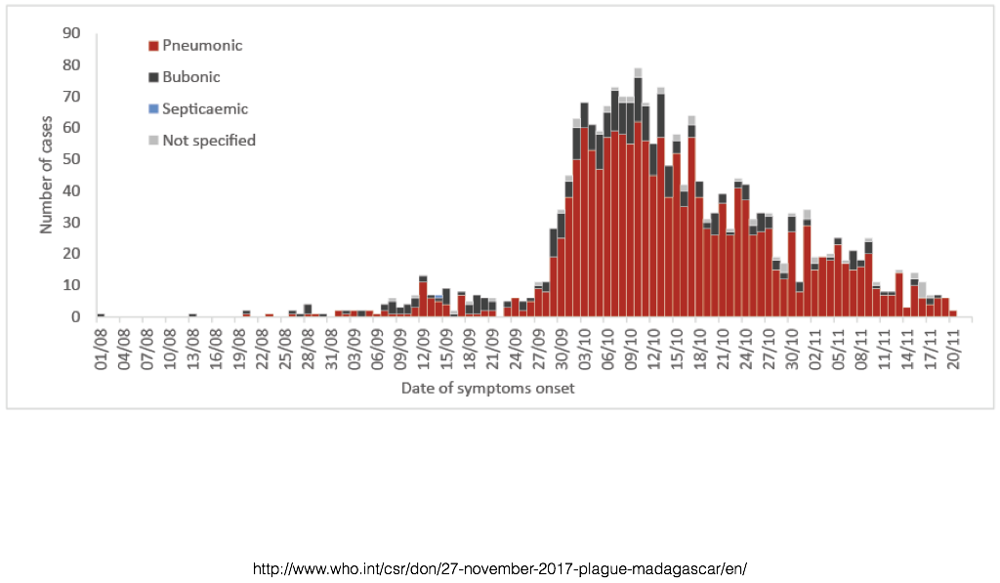
Which model is best?
Notes:
and the point will be it depends on the question.
https://www.ncbi.nlm.nih.gov/pmc/articles/PMC2566243/

Slide 3
There are many statistical methods used to ‘fit’ models to data.

Slide 4
There are many statistical methods used to ‘fit’ models to data.
The method best suited for your work will depend on your model and your data.

Slide 5
There are many statistical methods used to ‘fit’ models to data.
The method best suited for your work will depend on your model and your data.
What are some measures of model fit used in E2M2 so far?

Slide 6
There are many statistical methods used to ‘fit’ models to data.
The method best suited for your work will depend on your model and your data.
What are some measures of model fit used in E2M2 so far?
Least squares
Log likelihood
AIC
(uses least squares or log-likelihood but penalizes by number of fitted parameters)

Slide 7
There are many statistical methods used to ‘fit’ models to data.
The method best suited for your work will depend on your model and your data.
What are some measures of model fit used in E2M2 so far?
Least squares
Log likelihood
AIC
(uses least squares or log-likelihood but penalizes by number of fitted parameters)
The R function ‘optim’ can be used to minimize these measures of model difference from the data.

Slide 8

An example of model selection: Bartonella spp. in Madagascar rats

Slide 9
Bartonella spp.
persistent erythrocyctic bacteria that are sometimes zoonotic
vectored by ticks, fleas, sand flies, mosquitoes
at least 8 human-infecting species
Bartonella bacilliformis = Carrion’s disease
Bartonella henselae = cat scratch fever
Bartonella quintana = trench fever

Slide 10
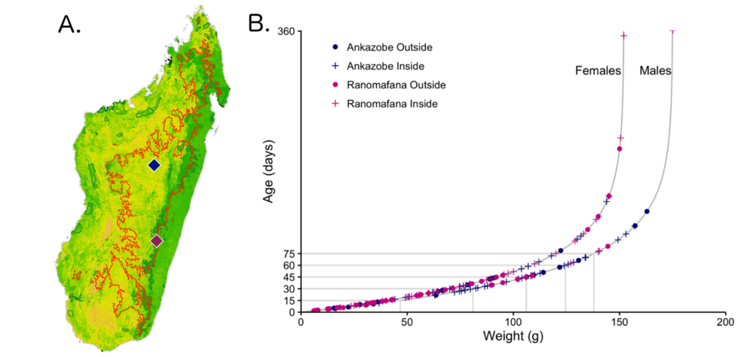
We first collected samples from rats in two sites Madagascar.

Slide 11
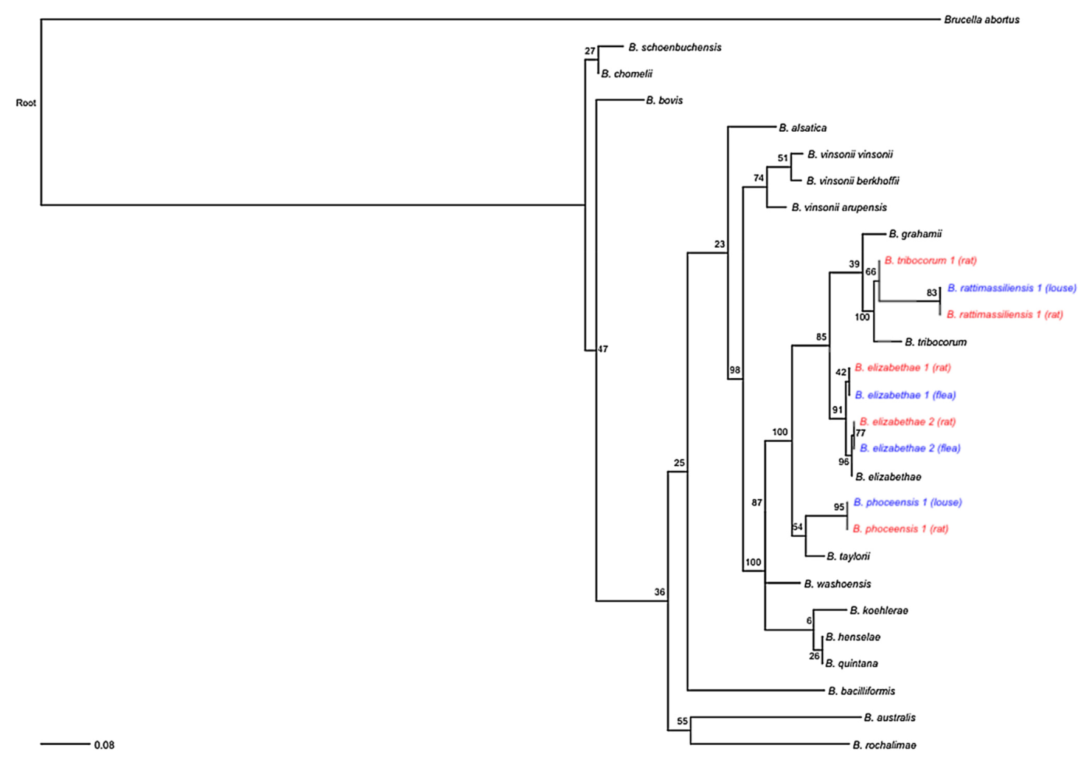
Statistically, we demonstrated an association between genotypes of Bartonella spp. found in rats and their ectoparasites.

Slide 12
Statistically, we demonstrated an association between genotypes of Bartonella spp. found in rats and their ectoparasites.
Does this demonstrate which ectoparasite acts as a vector of which Bartonella spp. strain?

Slide 13
Then, we asked: How does the rate of becoming infected vary with age?

Slide 14
Age-prevalence data allows for powerful inference into the dynamics of pathogen transmission.
βI
S
I
for a persistent, non-immunizing infection

Slide 15
Age-prevalence data allows for powerful inference into the dynamics of pathogen transmission.
λ
S
I
where λ, the force of infection, is the per capita rate at which susceptible hosts become infected

Slide 16
Age-prevalence data allows for powerful inference into the dynamics of pathogen transmission.
λ
with a persistent infection, we can assume that, if not infected, you must be susceptible….
1-I
I
where λ, the force of infection, is the per capita rate at which susceptible hosts become infected

Slide 17
Age-prevalence data allows for powerful inference into the dynamics of pathogen transmission.
λ
1-I
I
σ
and σ is the rate of recovery from infection

Slide 18
Age-prevalence data allows for powerful inference into the dynamics of pathogen transmission.
λ(a)
1-I(a)
I(a)
λ(a)
1-I(a)
I(a)
σ

Slide 19
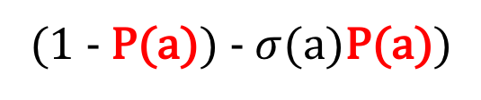
Age-prevalence data allows for powerful inference into the dynamics of pathogen transmission.
λ(a)
1-P(a)
P(a)
P(a)
(1 - P(a))
λ(a)
1-P(a)
P(a)
P(a)
(1 - P(a)) - $σ$(a)P(a))
σ
similar techniques can also be applied to age-seroprevalence data for immunizing infections

Slide 20
Let’s see which model works best for your data!

Slide 21
We found that an SI model offered the best fit to B. phoceensis data while the SIS model offered the best fit to the B. elizabethae data.
λ
Bartonella phoceensis
prevalence
S
I
Force of Infection (days-1)
λ
Bartonella elizabethae
prevalence
S
I
Force of Infection (days-1)
σ
Age (days)
Age (days)

Slide 22
The age-structured FOI identifies age cohorts most influential in an epidemic. Juveniles showed the highest FOI.
λ
Bartonella phoceensis
prevalence
S
I
Force of Infection (days-1)
λ
Bartonella elizabethae
prevalence
S
I
Force of Infection (days-1)
σ
Age (days)
Age (days)

Slide 23
